Slide 1
Integrated Sensing and Communications Lecturer: Dr. Rui Wang

Slide 2
Sensing
To detect the location, motion of mobile devices, vehicles or human
Sensing may improve the communication efficiency
Sensing may also provide services other than communications

Slide 3
IEEE 802.11bf
“802.11bf is a new Task Group about WLAN sensing within the IEEE 802.11 working group.”
“WLAN sensing is the use, by a WLAN sensing capable STA(s), of received WLAN signals to detect feature(s) of an intended target(s) in a given environment.”

Slide 4
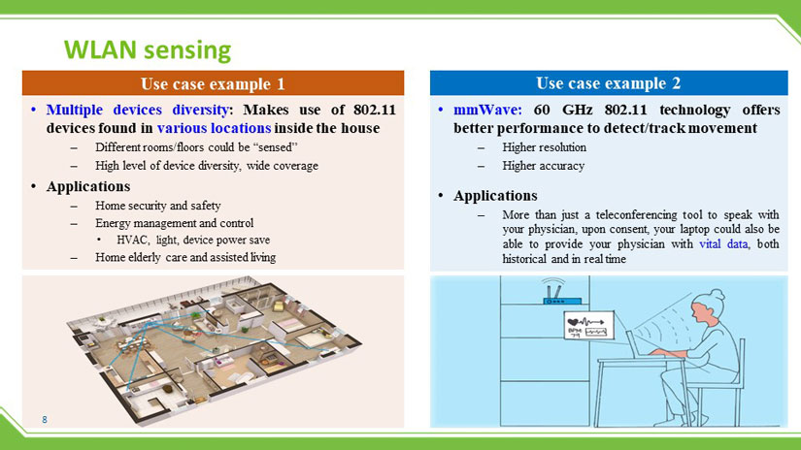
IEEE 802.11bf

Slide 5
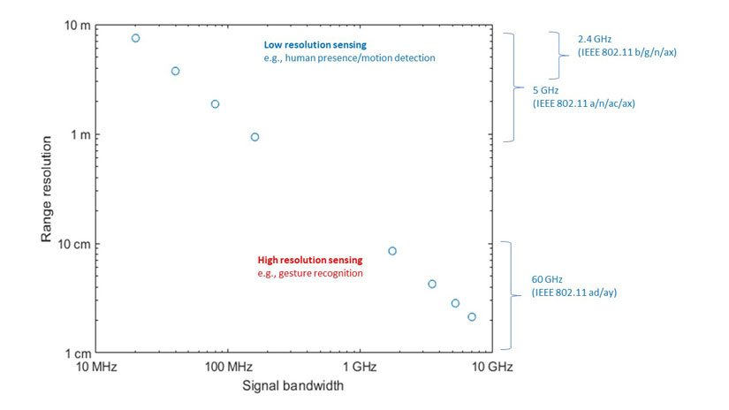
IEEE 802.11bf

Slide 6
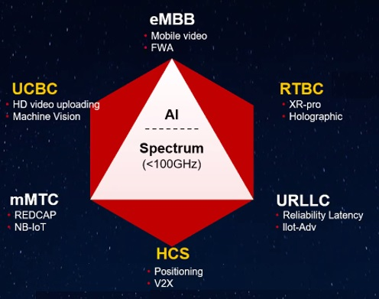
Sensing in 3GPP
Currently, 5G is not so successful in applications
Industry tries to define new application scenarios for cellular systems
Huawei: 5.5G

Slide 7
Sensing Modes and Parameters
Distance to the BS or mobile devices
Angles
Velocity
Motion
Proactive and passive

Slide 8


Proactive Sensing
Data Signals

Slide 9
Proactive Sensing
Data Signals
Echo

Slide 10
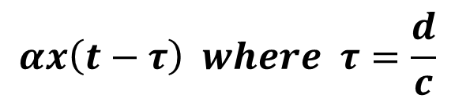

Proactive Sensing
$$x(t)$$
$$αx\left(t−τ\right) where τ=\frac{d}{c}$$
Data Signals
Echo

Slide 11
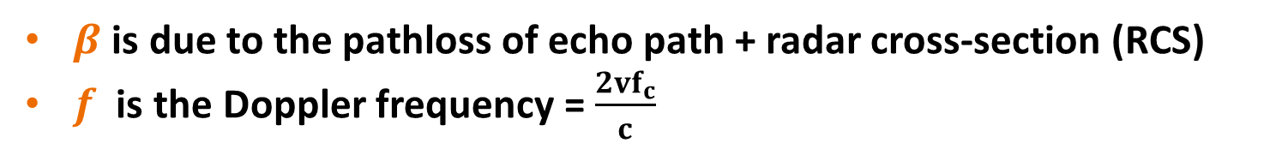
Proactive Sensing
$$x(t)$$
$$αx\left(t−τ\right) where τ=\frac{d}{c}$$
Data Signals
Echo
$$αβx\left(t−2τ\right)e^{j2πft}$$
Velocity v
$β$ is due to the pathloss of echo path + radar cross-section (RCS)
$f$ is the Doppler frequency = $\frac{2vf_{c}}{c}$

Slide 12
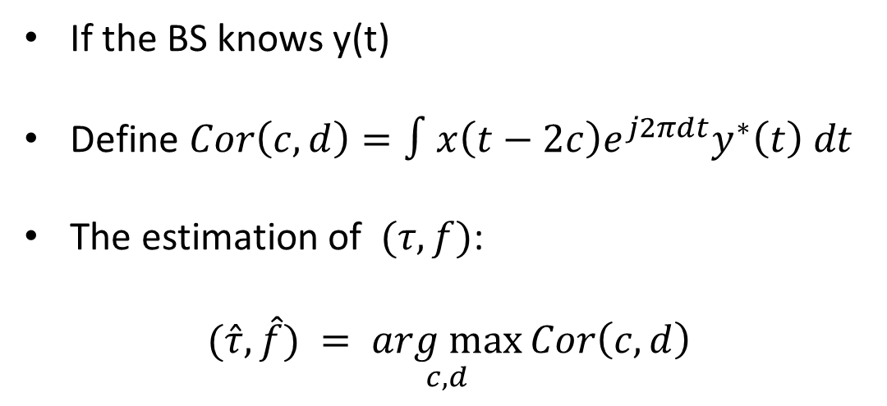
Proactive Sensing
$$x(t)$$
If the BS knows y(t)
Define $Cor\left(c,d\right)=∫x\left(t−2c\right)e^{j2πdt}y^{∗}\left(t\right) dt$
The estimation of $(τ,f)$:
$$(\hat{τ},\hat{f}) = \underset{c,d}{arg max}{Cor\left(c,d\right)}$$
$$y\left(t\right)= αβx\left(t−2τ\right)e^{j2πft}$$

Slide 13
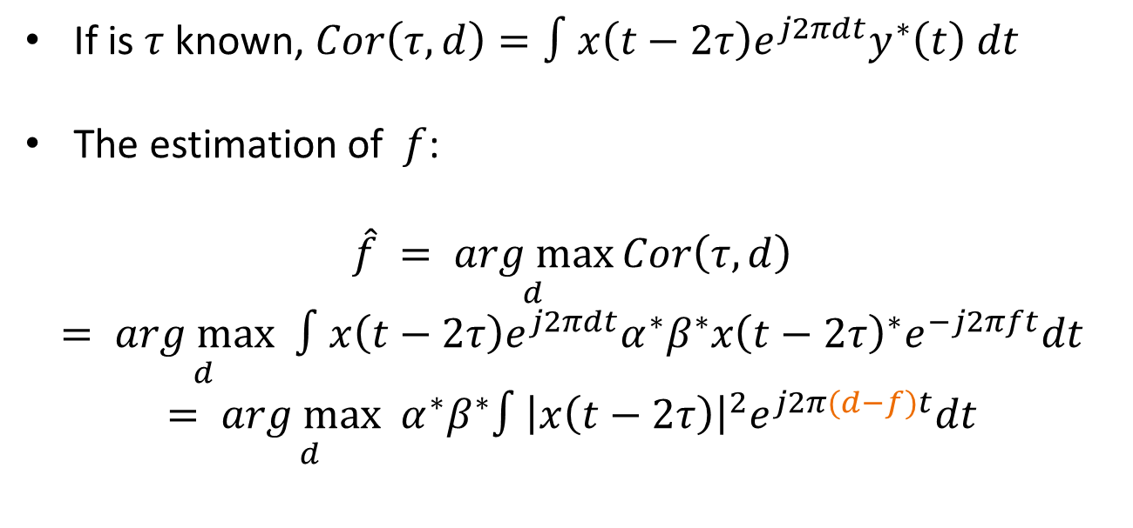
Proactive Sensing: Analysis
$$x(t)$$
If is $τ$known, $Cor\left(τ,d\right)=∫x\left(t−2τ\right)e^{j2πdt}y^{∗}\left(t\right) dt$
The estimation of $f$:
$$\hat{f} = \underset{d}{arg max}{Cor\left(τ,d\right)}$$
$$= \underset{d}{arg max}∫x\left(t−2τ\right)e^{j2πdt}α^{∗}β^{∗}x{\left(t−2τ\right)}^{∗}e^{−j2πft}dt$$
$$= \underset{d}{arg max}α^{∗}β^{∗}∫{\left|x\left(t−2τ\right)\right|}^{2}e^{j2π(d−f)t}dt$$
$$y\left(t\right)= αβx\left(t−2τ\right)e^{j2πft}$$

Slide 14
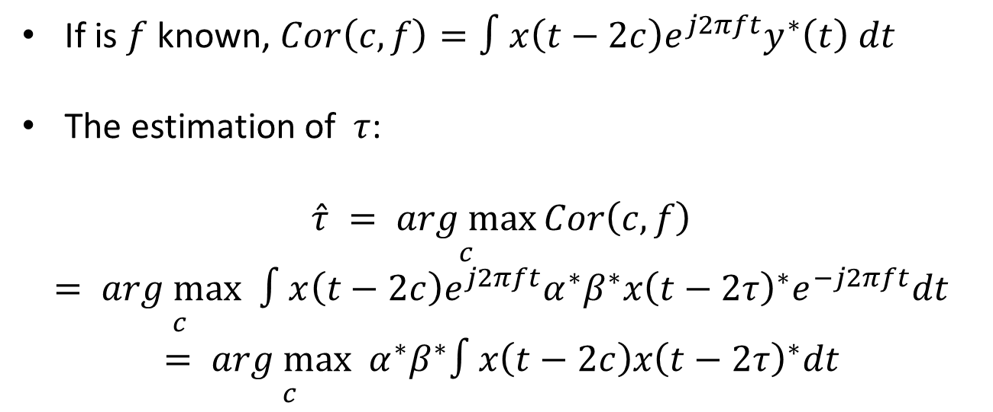
Proactive Sensing: Analysis
$$x(t)$$
If is $f$known, $Cor\left(c,f\right)=∫x\left(t−2c\right)e^{j2πft}y^{∗}\left(t\right) dt$
The estimation of $τ$:
$$\hat{τ} = \underset{c}{arg max}{Cor\left(c,f\right)}$$
$$= \underset{c}{arg max}∫x\left(t−2c\right)e^{j2πft}α^{∗}β^{∗}x{\left(t−2τ\right)}^{∗}e^{−j2πft}dt$$
$$= \underset{c}{arg max}α^{∗}β^{∗}∫x\left(t−2c\right)x{\left(t−2τ\right)}^{∗}dt$$
$$y\left(t\right)= αβx\left(t−2τ\right)e^{j2πft}$$

Slide 15
Proactive Sensing: Full Duplexing
$$x(t)$$
The BS should knows y(t)
BS is sending x(t) => It must be full duplex
Full duplex is currently a huge challenge for data transceiver design
$$y\left(t\right)= αβx\left(t−2τ\right)e^{j2πft}$$

Slide 16
Proactive Sensing: TDMA
$$x(t)$$
The BS sends the radar and data waves in different time
Radar wave: Frequency Modulated Continuous Wave (FMCW)
Only require full duplexing in FMCW transmission – Easy-peasy
$$y\left(t\right)= αβx\left(t−2τ\right)e^{j2πft}$$

Slide 17
Passive Sensing
Data Signals
Echo

Slide 18

Passive Sensing
Data Signals
Data Signals
Echo
Passive Receiver

Slide 19
Passive Sensing
BS or car may not know the existence of passive receiver.
Surveillance Channel
Reference Channel
Passive Receiver

Slide 20


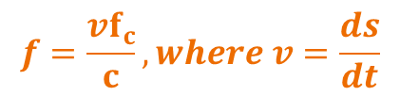

Passive Sensing
$$x(t)$$
$$τ_{s}=\frac{s}{c}$$
$$f=\frac{vf_{c}}{c}, where v=\frac{ds}{dt}$$
$$s$$
V is not the actual velocity of car
Surveillance Channel
Reference Channel
$$y_{s}\left(t\right)= βx\left(t−τ_{s}\right)e^{j2πft}$$
$$y_{r}\left(t\right)=αx\left(t−τ_{r}\right)$$
Passive Receiver

Slide 21
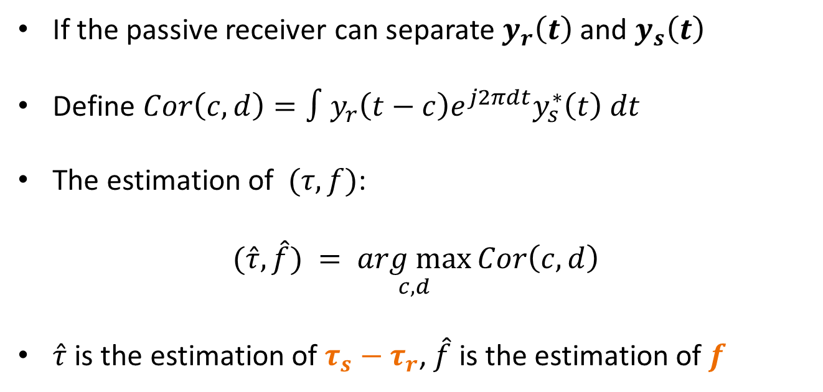
Passive Sensing
If the passive receiver can separate $y_{r}\left(t\right)$ and $y_{s}\left(t\right)$
Define $Cor\left(c,d\right)=∫y_{r}\left(t−c\right)e^{j2πdt}y_{s}^{∗}\left(t\right) dt$
The estimation of $(τ,f)$:
$$(\hat{τ},\hat{f}) = \underset{c,d}{arg max}{Cor\left(c,d\right)}$$
$\hat{τ}$ is the estimation of $τ_{s}−τ_{r}$, $\hat{f}$ is the estimation of $f$
$$y_{r}\left(t\right)=αx\left(t−τ_{r}\right)$$
$$y_{s}\left(t\right)= βx\left(t−τ_{s}\right)e^{j2πft}$$

Slide 22




Passive Sensing
$$ρ_{bs},θ_{bs}$$
$$ρ_{c},θ_{c},v_{c}=?$$

Slide 23


Passive Sensing
Step 1: $θ_{c}$ can be estimated via the phased array of the passive receiver, e.g., MUSIC algorithm
$$ρ_{bs},θ_{bs}$$
$$ρ_{c},θ_{c},v_{c}=?$$

Slide 24


Passive Sensing
Step 1: $θ_{c}$ can be estimated via the phased array of the passive receiver, e.g., MUSIC algorithm
Step 2: with $ρ_{bs}$ and $\hat{τ}$, the distance of surveillance channel s can be estimated
$$s$$
$$ρ_{bs},θ_{bs}$$
$$ρ_{c},θ_{c},v_{c}=?$$

Slide 25


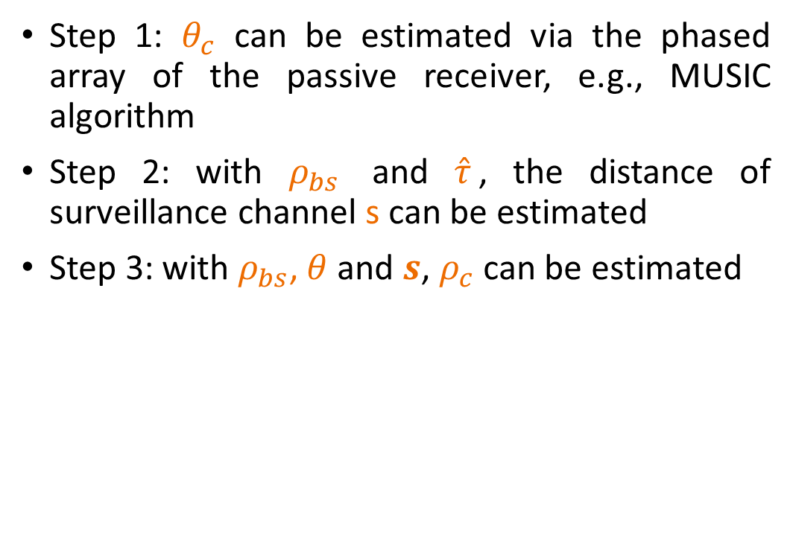


Passive Sensing
Step 1: $θ_{c}$ can be estimated via the phased array of the passive receiver, e.g., MUSIC algorithm
Step 2: with $ρ_{bs}$ and $\hat{τ}$, the distance of surveillance channel s can be estimated
Step 3: with $ρ_{bs}$, $θ$ and $s$, $ρ_{c}$ can be estimated
$$s=ρ_{c}+d_{bs−c}$$
$$d_{bs−c}$$
$$ρ_{bs},θ_{bs}$$
$$ρ_{c},θ_{c},v_{c}=?$$
$$θ=θ_{bs}−θ_{c}$$

Slide 26

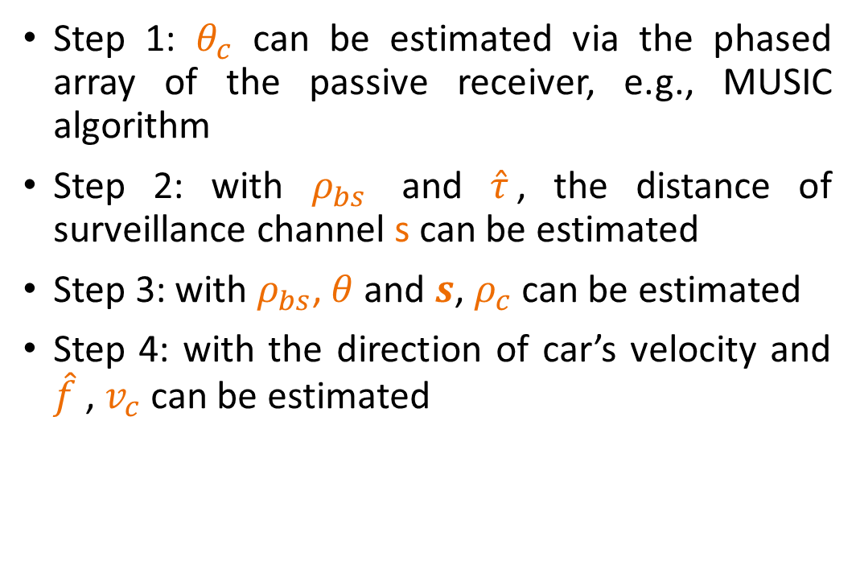
Passive Sensing
Step 1: $θ_{c}$ can be estimated via the phased array of the passive receiver, e.g., MUSIC algorithm
Step 2: with $ρ_{bs}$ and $\hat{τ}$, the distance of surveillance channel s can be estimated
Step 3: with $ρ_{bs}$, $θ$ and $s$, $ρ_{c}$ can be estimated
Step 4: with the direction of car’s velocity and $\hat{f}$ , $v_{c}$ can be estimated
$$s=ρ_{c}+d_{bs−c}$$
$$d_{bs−c}$$
$$ρ_{bs},θ_{bs}$$
$$ρ_{c},θ_{c},v_{c}=?$$
$$θ=θ_{bs}−θ_{c}$$

Slide 27
MUSIC Algorithm
multiple signal classification (MUSIC) algorithm is widely used to detect the Angle-of-Arrival (AoA) of antenna array
The number of AoAs should not be larger than the number of antennas
Spatial smoothing, improved algorithms, …

Slide 28

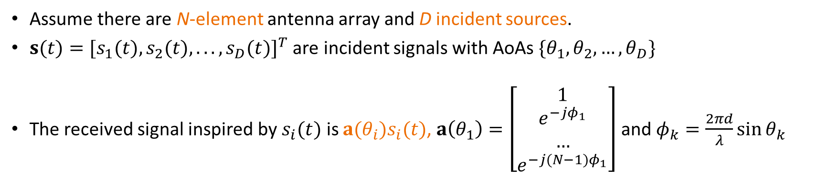



Signal Model
......
d
$$x_{N}(t)$$
$$x_{N−1}(t)$$
$$x_{N−2}(t)$$
$$x_{1}(t)$$
Assume there are N-element antenna array and D incident sources.
$s(t)=[s_{1}(t),s_{2}(t),...,s_{D}(t)]^{T}$ are incident signals with AoAs $\{θ_{1},θ_{2},…,θ_{D}\}$
The received signal inspired by $s_{i}(t)$ is $a(θ_{i})s_{i}(t)$, $a\left(θ_{1}\right)=\left[\begin{matrix}1 \\ \begin{aligned}e^{−jφ_{1}} \\ … \\ e^{−j(N−1)φ_{1}}\end{aligned}\end{matrix}\right]$ and $φ_{k}=\frac{2πd}{λ}\sin{θ_{k}}$

Slide 29
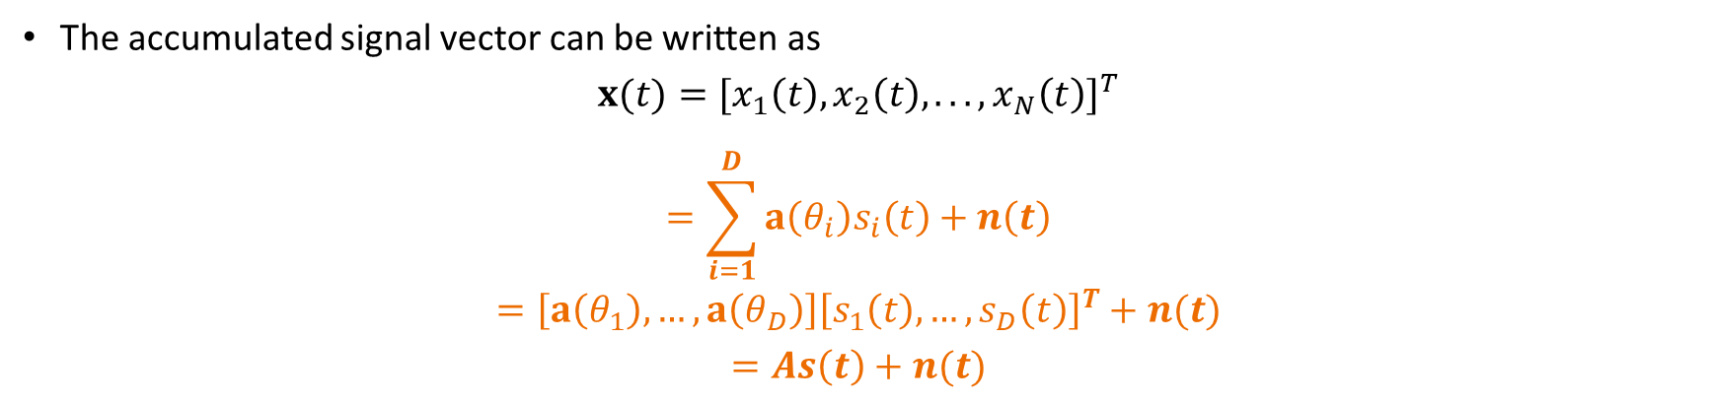
Signal Model
......
d
$$x_{N}(t)$$
$$x_{N−1}(t)$$
$$x_{N−2}(t)$$
$$x_{1}(t)$$
The accumulated signal vector can be written as
$$x(t)=[x_{1}\left(t\right),x_{2}\left(t\right),...,x_{N}\left(t\right)]^{T}$$
$$=\sum_{i=1}^{D}{a\left(θ_{i}\right)s_{i}\left(t\right)}+n\left(t\right)$$
$$=\left[a\left(θ_{1}\right),…,a\left(θ_{D}\right)\right]{\left[s_{1}\left(t\right),…, s_{D}\left(t\right)\right]}^{T}+n(t)$$
$$=As\left(t\right)+n(t)$$

Slide 30
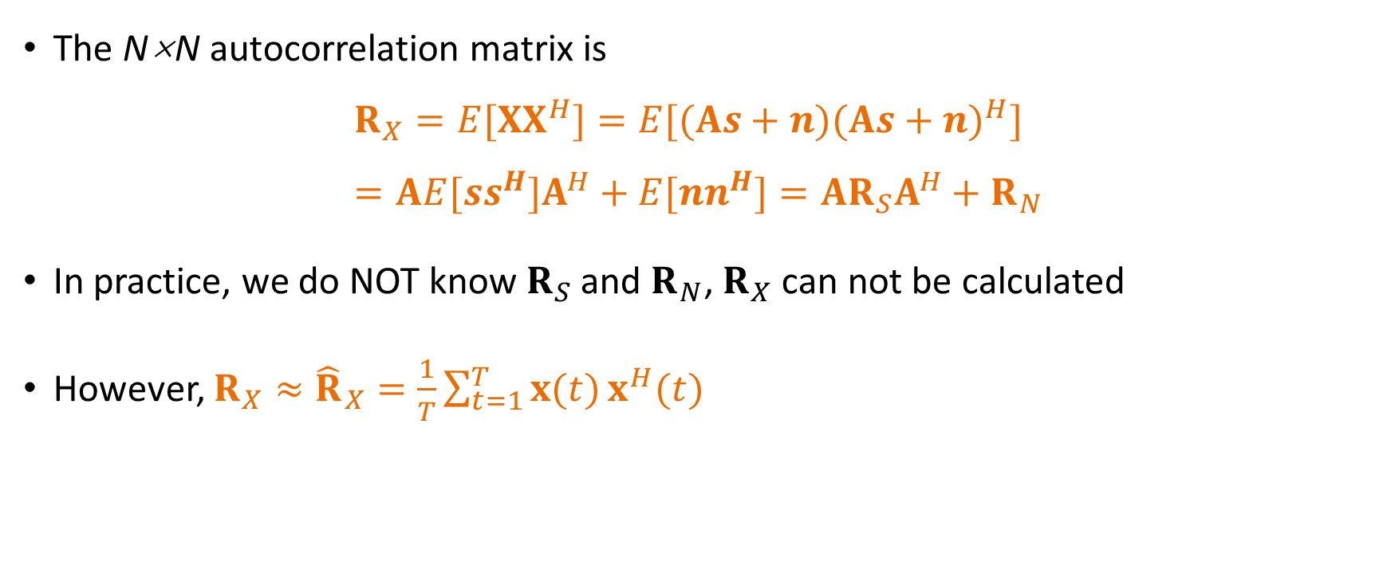
Covariance Matrix
The N×N autocorrelation matrix is
$$R_{X}=E[XX^{H}]=E[(As+n)(As+n)^{H}] \\ =AE[ss^{H}]A^{H}+E[nn^{H}]=AR_{S}A^{H}+R_{N}$$
In practice, we do NOT know $R_{S}$ and $R_{N}$, $R_{X}$ can not be calculated
However, ${R_{X}≈\hat{R}}_{X}=\frac{1}{T}\sum_{t=1}^{T}{x(t)}x^{H}(t)$

Slide 31


MUSIC Algorithm
Eigen value decomposition of $R_{X}$ with $λ_{1}≥λ_{2}≥…≥λ_{N}$
$$R_{X}\left[v_{1},v_{2},…,v_{N}\right]=\left[v_{1},v_{2},…,v_{N}\right]\left[\begin{matrix}λ_{1} & 0 & 0 \\ 0 & ⋱ & 0 \\ 0 & 0 & λ_{N}\end{matrix}\right]$$
$$R_{X}=\left[v_{1},v_{2},…,v_{N}\right]\left[\begin{matrix}λ_{1} & 0 & 0 \\ 0 & ⋱ & 0 \\ 0 & 0 & λ_{N}\end{matrix}\right]{\left[v_{1},v_{2},…,v_{N}\right]}^{−1}$$
$$R_{X}=\left[v_{1},v_{2},…,v_{N}\right]\left[\begin{matrix}λ_{1} & 0 & 0 \\ 0 & ⋱ & 0 \\ 0 & 0 & λ_{N}\end{matrix}\right]{\left[v_{1},v_{2},…,v_{N}\right]}^{H}$$
Unitary since $R_{X}$is complex symmetric

Slide 32
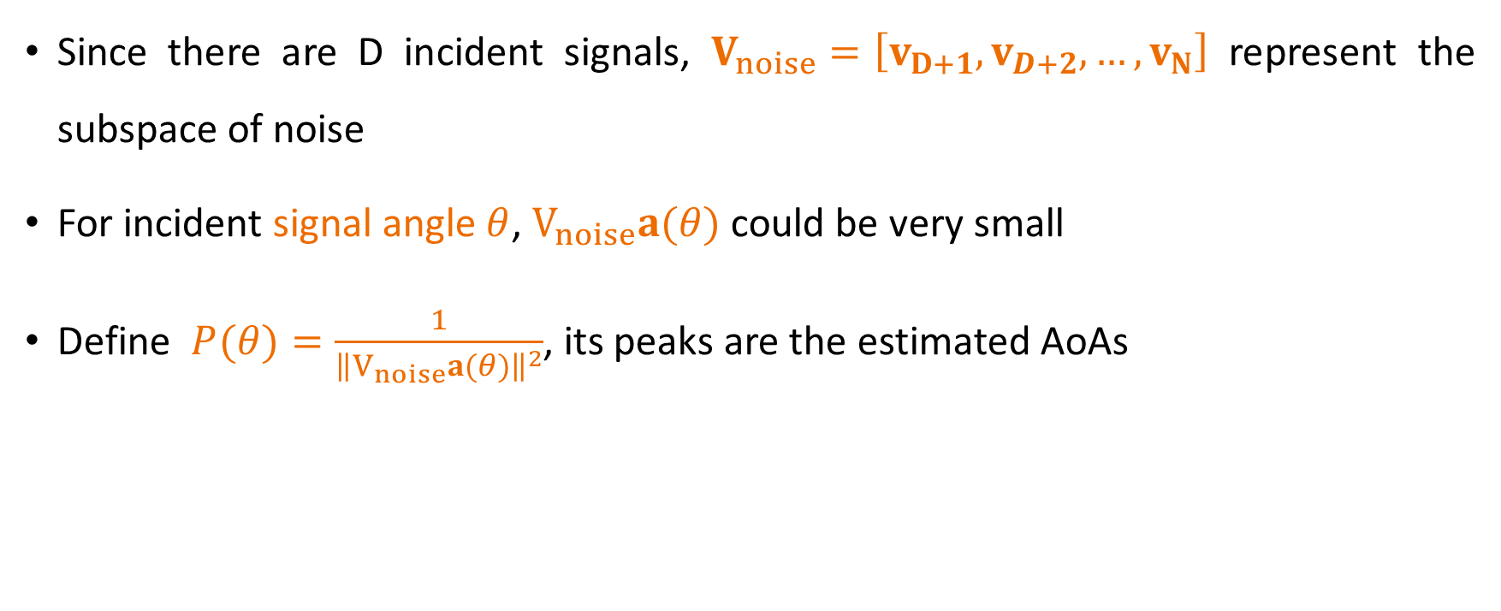
MUSIC Algorithm
Since there are D incident signals, $V_{noise}=\left[v_{D+1},v_{D+2},…,v_{N}\right]$ represent the subspace of noise
For incident signal angle $θ$, $V_{noise}a(θ)$ could be very small
Define $P(θ)=\frac{1}{{\left\|V_{noise}a(θ)\right\|}^{2}}$, its peaks are the estimated AoAs

Slide 33

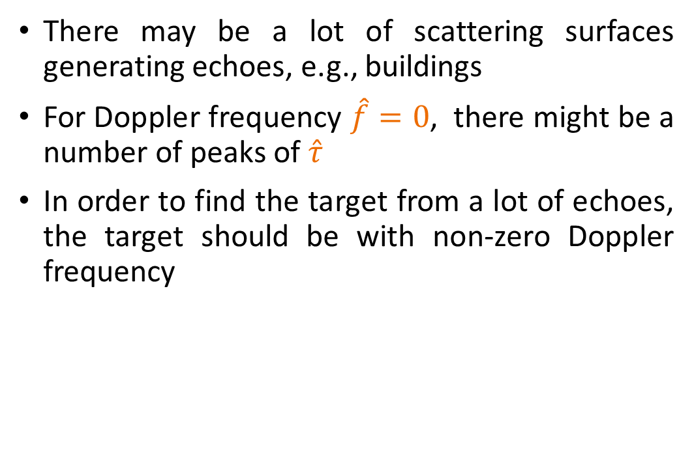
Limitation of Sensing
There may be a lot of scattering surfaces generating echoes, e.g., buildings
For Doppler frequency $\hat{f}=0$, there might be a number of peaks of $\hat{τ}$
In order to find the target from a lot of echoes, the target should be with non-zero Doppler frequency

Slide 34
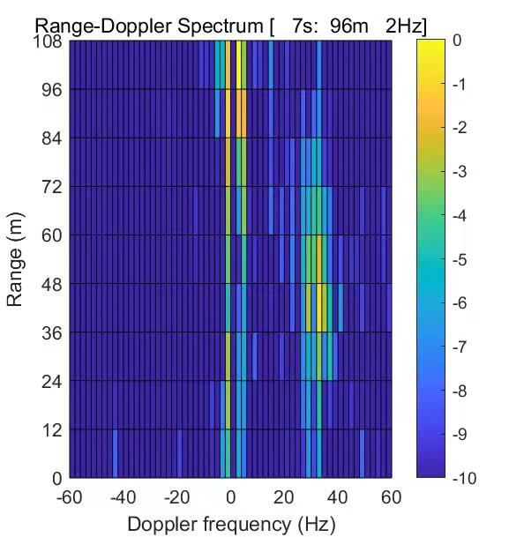
Limitation of Sensing

Slide 35
Tips for Homework
Use MUSIC algorithm to detect the DoA of 4-antenna array, and find the main reflectors
The LoS path and reflecting path align with the boresight of both arrays

